Slide 1
Chapter 2.12 Translating and Starting a Program & A.1-A.4

Slide 2
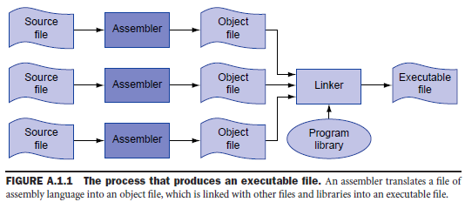
A. 1 Introduction
§A.1 Introduction
Humans: read and write symbols (words)
Computer: binary numbers
Describe the process of translating a human-readable program into a computer executable program.

Slide 3
Assembly language is the symbolic representation of a computer’s binary encoding – the machine language.
Machine Language: binary representation used for communication within a computer system.
Assembler: an assembler reads a single assembly language source file and produces an object file containing machine instructions and bookkeeping information that helps combine several object files into a program.
Linker: combines a collection of object and library files into an executable file, which a computer can run.

Slide 4
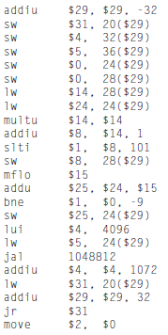
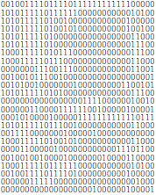
FIGURE A.1.2 MIPS machine language code for a routine to compute and print the sum of the squares of integers between 0 and 100.
FIGURE A.1.3 The same routine as in FIGURE A.1.2 written in assembly language.
Easier to read: operations and operands are written with symbols rather than with bit patterns.
Difficult to follow: memory locations are named by addresses rather than by a symbolic label.

Slide 5
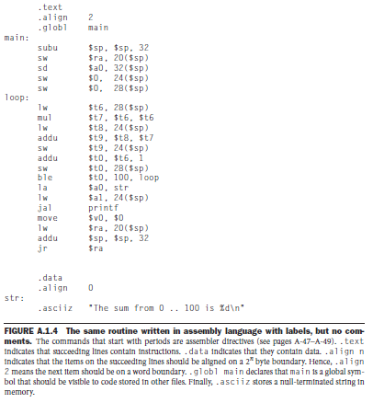
Assembler directives: an operation that tells the assembler how to translate a program but does not produce machine instructions; always begins with a period (e.g., .data, .global).
Labels: names followed by a colon, such as main: or loop: or str:.
Still difficult to follow:
Many simple operations are required to accomplish simple tasks.
Assembly language is lack of control flow constructs
High level language:
Variables have mnemonic names
The loop is explicit rather than constructed with branches.

Slide 6
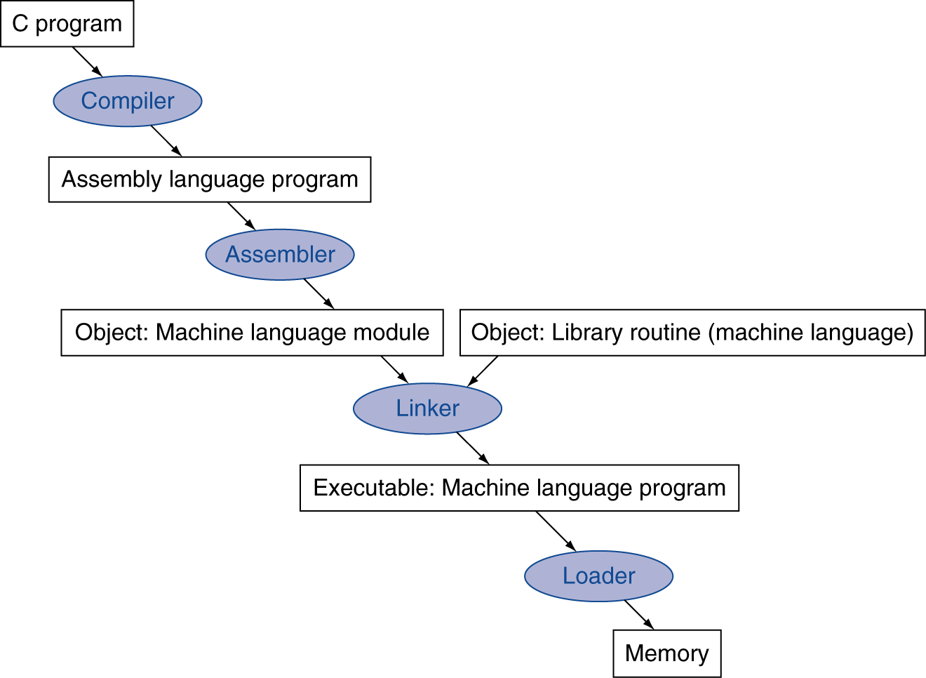
Translation and Startup
Many compilers produce object modules directly
§2.12 Translating and Starting a Program
Static linking

Slide 7
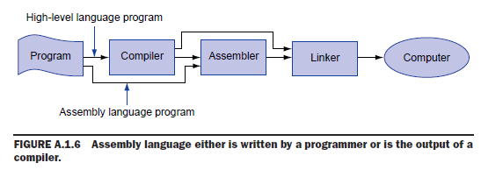
Compiler
Complier: translate a high-level language program into an equivalent program in machine or assembly language.

Slide 8
Assembly Program Template
# Title: Filename:
# Author: Date:
# Description:
# Input:
# Output:
################# Data segment #####################
.data
. . .
################# Code segment #####################
.text
.globl main
main: # main program entry
. . .
li $v0, 10 # Exit program
syscall

Slide 9
.DATA, .TEXT, & .GLOBL Directives
.DATA directive
Defines the data segment of a program containing data
The program's variables should be defined under this directive
Assembler will allocate and initialize the storage of variables
.TEXT directive
Defines the code segment of a program containing instructions
.GLOBL directive
Declares a symbol as global
Global symbols can be referenced from other files
We use this directive to declare main procedure of a program

Slide 10
Data Definition Statement
Sets aside storage in memory for a variable
May optionally assign a name (label) to the data
Syntax:
[name:] directive initializer [, initializer] . . .
var1: .WORD 10
All initializers become binary data in memory

Slide 11
Data Directives
.BYTE Directive
Stores the list of values as 8-bit bytes
.HALF Directive
Stores the list as 16-bit values aligned on half-word boundary
.WORD Directive
Stores the list as 32-bit values aligned on a word boundary
.FLOAT Directive
Stores the listed values as single-precision floating point
.DOUBLE Directive
Stores the listed values as double-precision floating point

Slide 12
String Directives
.ASCII Directive
Allocates a sequence of bytes for an ASCII string
.ASCIIZ Directive
Same as .ASCII directive, but adds a NULL char at end of string
Strings are null-terminated, as in the C programming language
.SPACE Directive
Allocates space of n uninitialized bytes in the data segment

Slide 13
Examples of Data Definitions
.DATA
var1: .BYTE 'A', 'E', 127, -1, '\n'
var2: .HALF -10, 0xffff
var3: .WORD 0x12345678:100
var4: .FLOAT 12.3, -0.1
var5: .DOUBLE 1.5e-10
str1: .ASCII "A String\n"
str2: .ASCIIZ "NULL Terminated String"
array: .SPACE 100
Array of 100 words
100 bytes (not initialized)

Slide 14
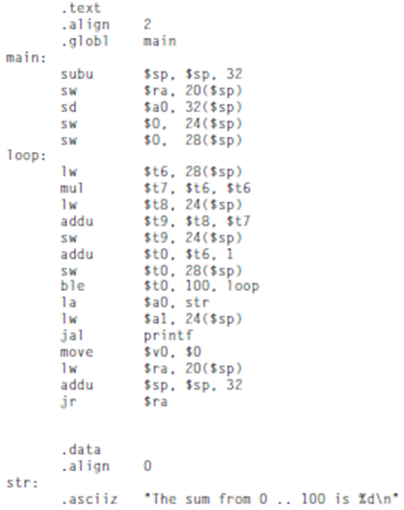
Local and Global Labels
Global label (also called external label): a label object can be referenced from files other than the file in which it is defined.
Example: label “main”
Local label: a label referring to an object that can be used only within the file in which it is defined.
Example: label “loop” and “str”.
Only global labels are visible outside a file.

Slide 15
A.2 Assemblers
§2 Assemblers
An assembler translates a file of assembly language statements into a file of binary machine instructions.
Two steps:
Step 1: Create symbol table: map labels to memory addresses
Step 2: translate each assembly statement by combining the numeric equivalents of opcodes, register specifiers, and labels into binary machine codes.
Assembler produces an object file, which contains the machine instructions, data and bookkeeping information.

Slide 16

Object File Format
An object file on UNIX contains six distinct sections.
Object file header: describe the size and position of the other pieces of the file.
Text segment: contains the machine language code for routines in the source file.
Data segment: contains a binary representation of the initialized data used by the program.
Relocation information: identify instructions and data words that depend on absolute addresses when the program is loaded into memory.
Symbol table: associates addresses with external labels in the source file and lists unresolved references.
Debugging information: contains a concise description of the way the program was complied.

Slide 17


Additional Facilities
Assemblers provide a variety of features that help make assembler programs shorter and easier to write, but do not fundamentally change assembly language.
Data layout directives: specify data in a human-readable form that the assembler translate to binary.

Slide 18
Additional Facilities - Macro
A pattern-matching and replacement facility that provides a simple mechanism to name a frequently used sequence of instructions.
Macro vs. Subroutines
Permit a programmer to create and name a new abstraction for a common operation.
Macros do not cause a subroutine call and return when the program runs.
A macro call is replaced by the macro’s body when the program is assembled.

Slide 19
Macro Example

Slide 20
Additional Facilities -Pseudoinstructions
Pseudoinstructions: instructions provided by an assembler but not implemented in hardware.
Pseudoinstructions extend the instruction set, which makes assembly language programming easier without complicating the hardware.
Example:
move $t0, $t1 → add $t0, $zero, $t1
blt $t0, $t1, L → slt $at, $t0, $t1 bne $at, $zero, L

Slide 21
A.3 Linkers
§A.3 Linkers
Separate compilation:
Permits a program to be split into pieces that are stored in difference files.
Each file contains a logically related collection of subroutines and data structures that form a module in a large program.
A file can be complied and assembled independently of other files.
Changes to one module do not require recompiling the entire program.
Requires an additional step of linking to combine object files from separate modules and fixing their unsolved references.
Linker performs three tasks:
Merges segments
Resolve labels (determine their addresses)
Patch location-dependent and external refs

Slide 22
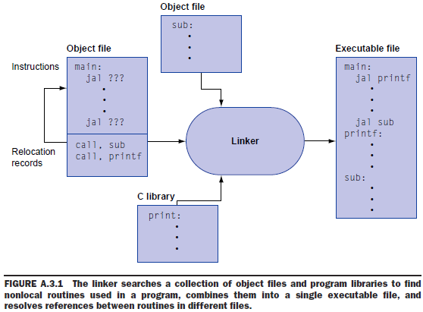
Linker

Slide 23
A.4 Loading
§A.4 Loading
Before running a program, the program resides in a file on secondary storage, such as a disk.
Operating system (OS) brings a program into memory and starts its running:
Reads the executable file header to determine the size of the text and data segments.
Allocates memory space large enough for the text and data segments.
Copies instructions and data from the executable file into memory.
Copies arguments (if any) to the main program onto the stack.
Initializes the machine registers. In general most registers are cleared, but the stack pointer must be assigned to the address of the first free stack location.
Jumps to a start up routine that copies the program’s parameters into te argument registers and calls the program’s main routine. If the main routine returns, the start-up routine terminates the program with the exit system call.

Slide 24
Dynamically Linked Libraries
Library routines that are linked to a program during execution.
Both the program and library routines keep extra information on the location of nonlocal procedures and their names.
The loader runs a dynamic linker, using the extra information in the file to find the appropriate libraries and to update the external ferences.
Initial version of DLL:
Link all routines of the library.
Lazy procedure linkage: each routine is linked only after it is called.

Slide 25
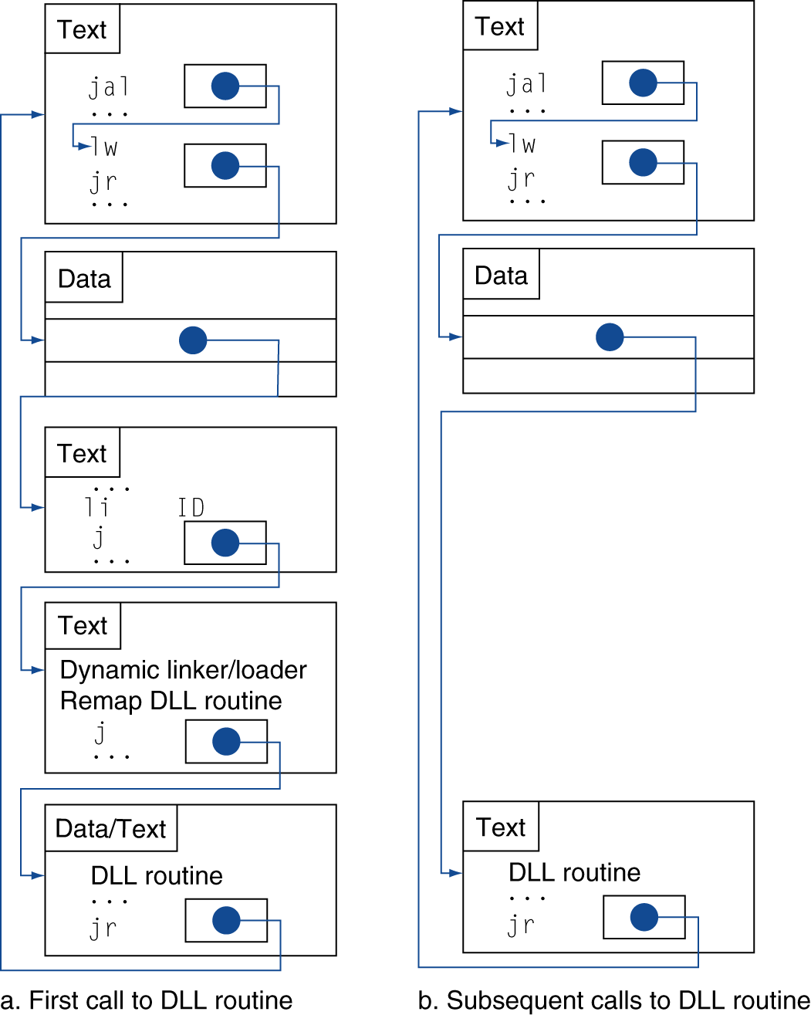
Lazy Linkage

Slide 26
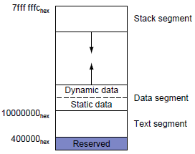
A.5 Memory Usage
§A.5 Memory Usage
Memory is typically divided into three parts:
Text segment: holds the program’s instructions.
Data segment: further divided into two parts.
Static data: contains objects whose size is known to the complier and whose lifetime is the program’s entire execution, such as global variables in C. The linker both assigns static objects to locations in the data segments and resolves references to these objects.
Dynamic data: allocated by the program as it executes, such as the malloc library routine assigns dynamic memory space in C program.
Stack segment: the maximum size of a program’s stack is not known in advance. OS expands the stack segment down toward the data segment as the program pushes values on to the stack.

Slide 27
Memory Alignment
Memory is viewed as an array of bytes with addresses
Byte Addressing: address points to a byte in memory
Words occupy 4 consecutive bytes in memory
MIPS instructions and integers occupy 4 bytes
Alignment: address is a multiple of size
Word address should be a multiple of 4
Least significant 2 bits of address should be 00
Halfword address should be a multiple of 2
.ALIGN n directive
Aligns the next data definition on a 2^{n} byte boundary
Memory
. . .
address
aligned word
12
not aligned
8
4
0
not aligned

Slide 28
Symbol Table
Assembler builds a symbol table for labels (variables)
Assembler computes the address of each label in data segment
Example Symbol Table
.DATA
var1: .BYTE 1, 2,'Z'
str1: .ASCIIZ "My String\n"
var2: .WORD 0x12345678
.ALIGN 3
var3: .HALF 1000
Label
var1
str1
var2
var3
Address
0x10010000
0x10010003
0x10010010
0x10010018
var1
str1
0x10010000
1
2
'Z'
'M'
'y'
' '
'S'
't'
'r'
'i'
'n'
'g'
'\n'
0
0
0
Unused
0x10010010
0x12345678
0
0
0
0
1000
var2 (aligned)
Unused
var3 (address is multiple of 8)

Slide 29
Byte Ordering and Endianness
Processors can order bytes within a word in two ways
Little Endian Byte Ordering
Memory address = Address of least significant byte
Example: Intel IA-32, Alpha
Big Endian Byte Ordering
Memory address = Address of most significant byte
Example: SPARC, PA-RISC
MIPS can operate with both byte orderings
MSB
LSB
address
a
a+1
a+2
a+3
Byte 3
Byte 2
Byte 1
Byte 0
. . .
Byte 0
Byte 1
Byte 2
Byte 3
. . .
32-bit Register
Memory
MSB
LSB
address
a
a+1
a+2
a+3
Byte 3
Byte 2
Byte 1
Byte 0
. . .
Byte 3
Byte 2
Byte 1
Byte 0
. . .
32-bit Register
Memory

